Slide 1

Demo on FPGA PC communication
March 8,2014

Slide 2
Important Files for this Demo
makestuff-windows-20130719
libfpgalink-20120621.tar
libusb-win32-bin-1.2.6.0
[ Console-2.00b148-Beta_32bit ]
[ Microsoft Visual Studio ]

Slide 3
Steps for Working environment setup Demo
Download and install Visual C++ Express 2010
http://www.microsoft.com/visualstudio/en-us/products/2010- editions/express#Visual_Studio_2010_Express_Downloads
2. Download and install Microsoft Visual C++ 2010 Redistributable Package (x86)
http://www.microsoft.com/en-us/download/details.aspx?id=5555
Download "Build Infrastructure", windows version. This is the environment where we’ll work with the FPGALink library binaries.
http://www.makestuff.eu/wordpress/software/build-infrastructure/
On windows, unpack the downloaded archive
makestuff-win32-20111211.zip in your own directory.
In my case, I did this directly in C:\. This created C:\makestuff\.

Slide 4
4. Download the latest FPGALink library binaries (at the time of writing this lab, the latest version is "libfpgalink-20120621.tar.gz"
http://www.makestuff.eu/wordpress/software/fpgalink/
Unpack it in C:\makestuff\libs\
5. Download and install "Console 2".
http://sourceforge.net/projects/console
unpack the downloaded archive directly in C:\Program Files\
5.1 Create shortcut to C:\Program Files\Console2\Console.exe
5.2 Launch Console 2 and enter C:\makestuff\msys\bin\sh.exe --login in the "Shell" and C:\makestuff\ in startup dir box at Edit->Settings->Console

Slide 5
6. Download “LibUSB-Win32”. http://sourceforge.net/projects/libusb-win32/
Plug in the Atlys board and turn the power on. Then run bin/inf-wizard.exe. Click “Next”, select your FPGA board, make a note (in our case, the Atlys board, that is 1443, 0007) of the vendor and product IDs and click “Next” twice. Choose a location for the driver and click “Save”. Click “Install Now”.

Slide 6
VHDL coding and .xsvf programming file generation
Create ISE project suppose “Lab8”. Now add Copy of Source .
Files List
top_level.vhdl
comm_fpga_fx2.vhdl and
top_level.ucf

Slide 7
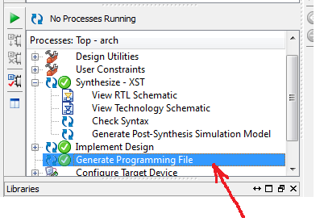
2. Create a .bit by double click on Generate Programming File

Slide 8
3. Creating .xsvf file
Inside ISE project Navigator, select Tools->iMPACT. The ISE iMPACT window should pop-up after a few seconds.
Double click on “Boundary Scan” and then right click at the white space as in the picture in the next slide and follow the picture

Slide 9
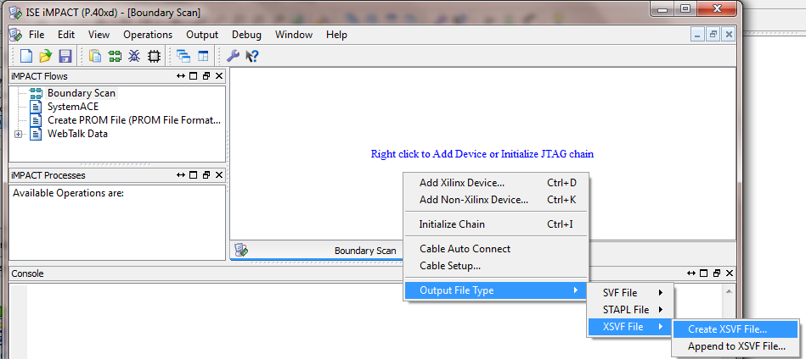
Now give the file name and the directory where your xsvf
file to be saved then click save

Slide 10
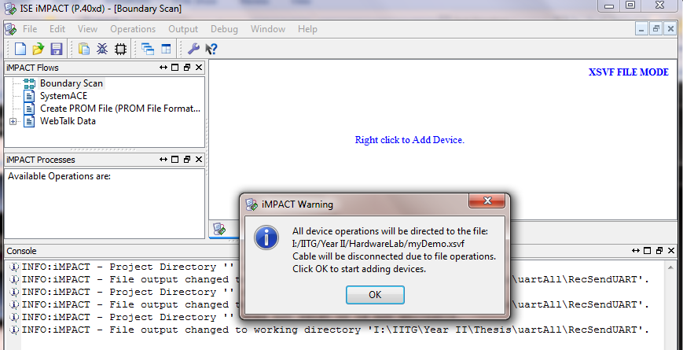
When you click Ok it will redirect you to select the .bit file
you already generate on slide 6

Slide 11
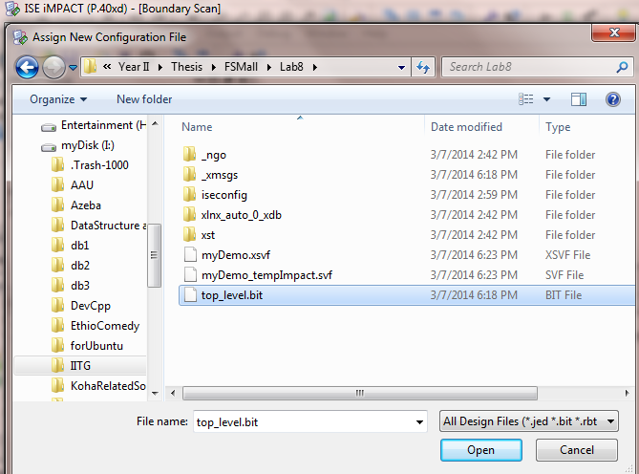
Select Your .bit file and click Open

Slide 12
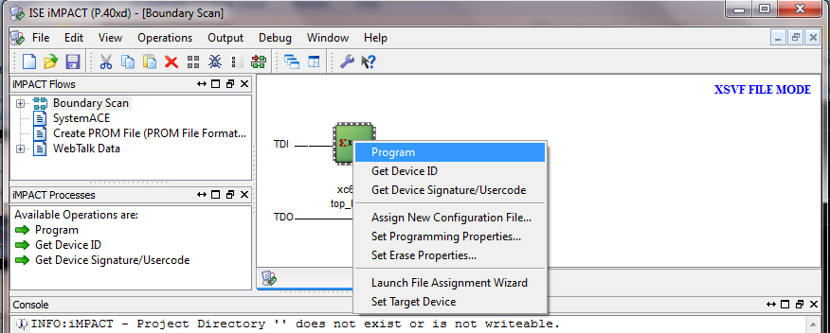

Now select the chip and right click then program then
on the coming window select the deice and click ok
Now you have done all , copy the .xsvf file to the directory
C:\makestuff\libs\gen_xsvf Note: new folder gen_xsvf

Slide 13
Testing and validation of the overall host-FPGA system
--Connect and power-on the Atlys board if not already.
--Start a terminal by launching Console 2. We’ll use the flcli utility on the host side.
--Use flcli utility to program the FPGA. In the Console 2 terminal, do:
> cd libs/libfpgalink-20120621
> ./win32/rel/flcli -v 1443:0007 -i 1443:0007 -s -x gen_xsvf/mydemo.xsvf

Slide 14
--Use flcli utility to connect to the FPGALink device 1443:0007 (that is the USB controller on the Atlys board):
> ./win32/rel/flcli -v 1443:0007 -c
Which enters the command-line mode, where we can use the flcli utility’s built-in functions to write and read the registers we have created on the FPGA. For example, try this:
> w0 37
And observe the LEDs on the board
3 | 7
0011 0111 Five LEDs toggle to ON

Slide 15
read the status of the slide switches:
> r0
Write into R1 and R2:
> w1 02;w2 03
> r1
> r2
> r3
If everything went OK, your Console 2 window should look like in Fig.4.
Quit the flcli utility:
> q

Slide 16
Thanks

